Slide 1
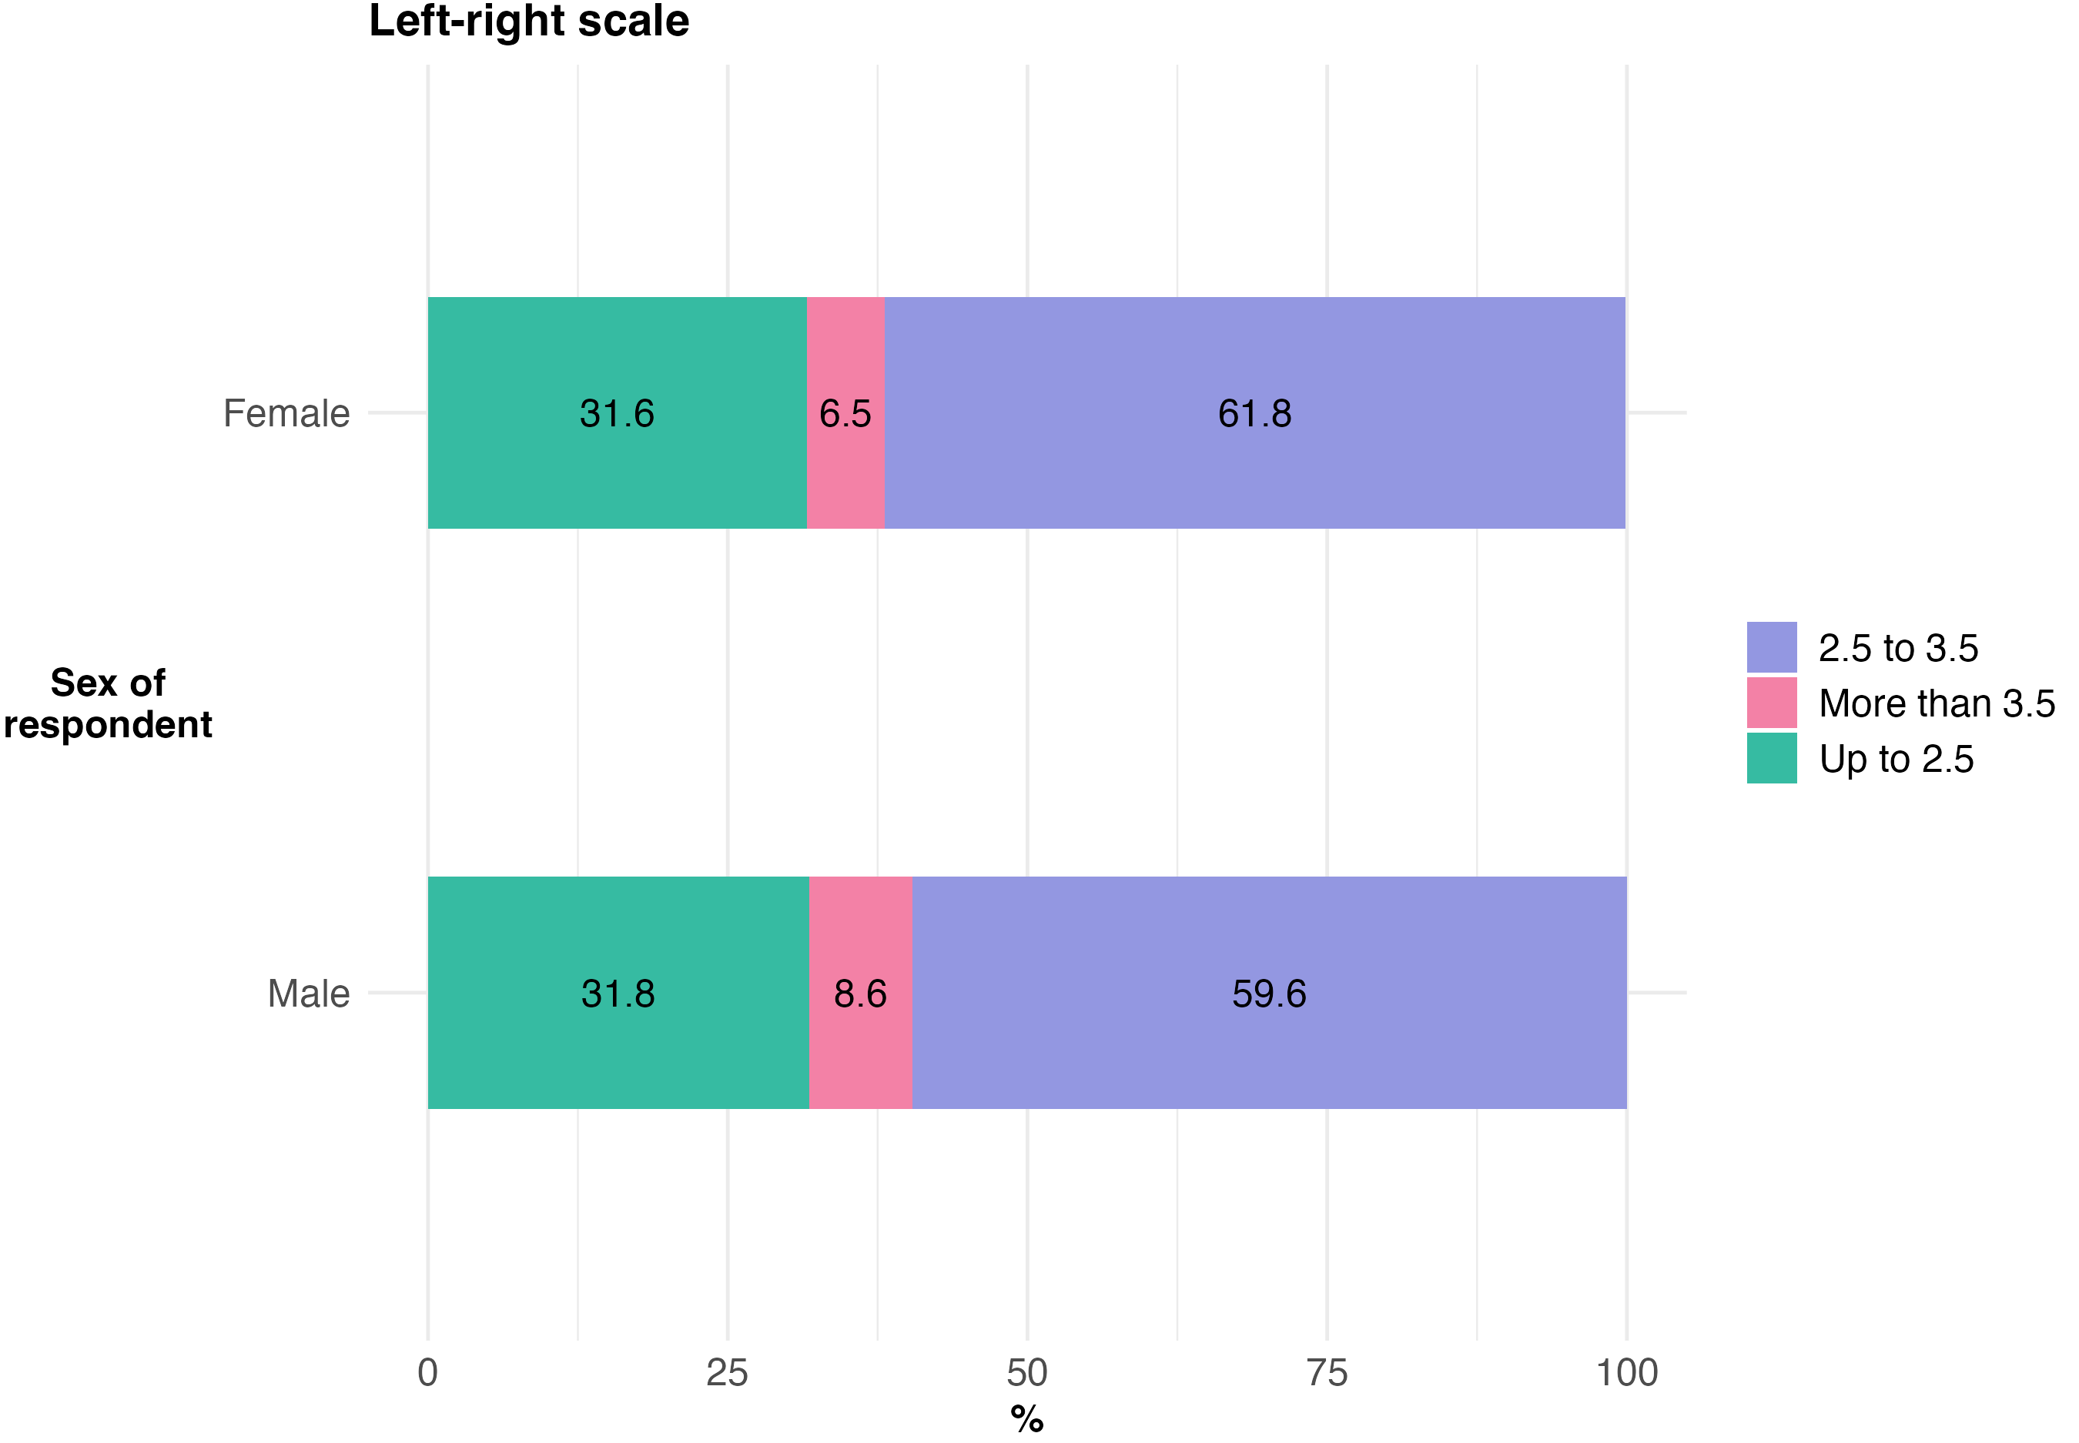
Unweighted sample sizes: Male: n=1217 | Female: n=1386

Slide 2
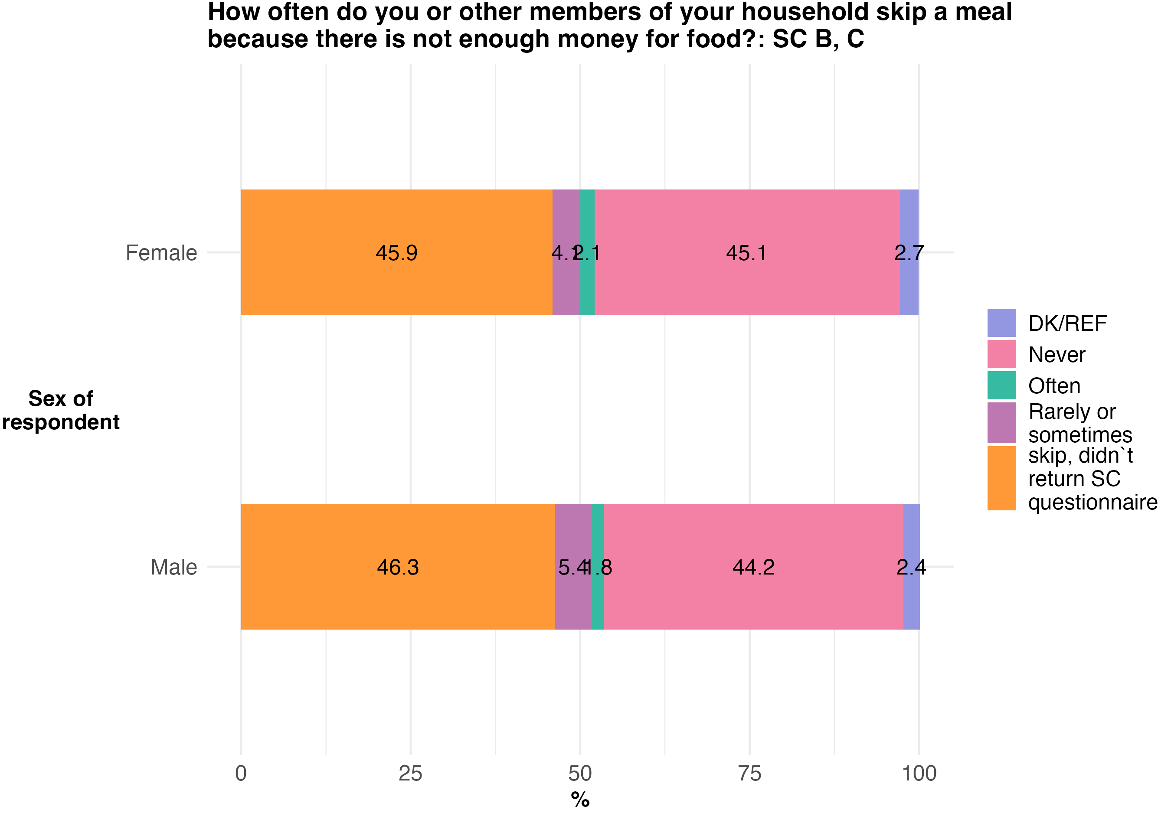
Unweighted sample sizes: Male: n=1492 | Female: n=1732

Slide 3
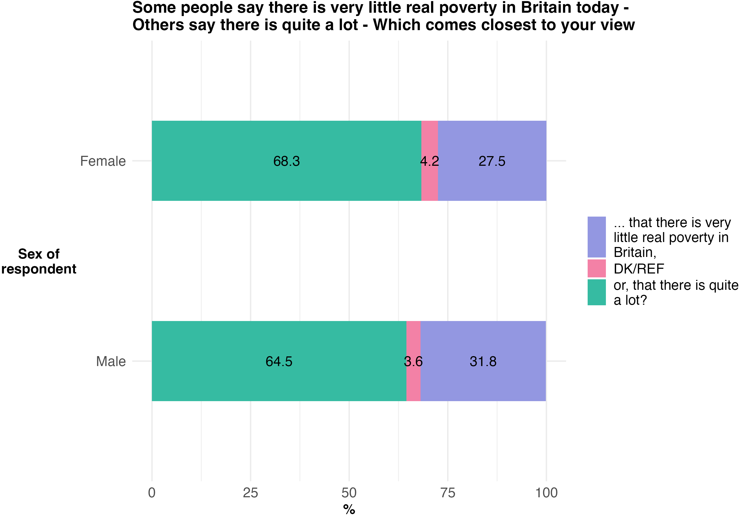
Unweighted sample sizes: Male: n=1492 | Female: n=1732

Slide 4
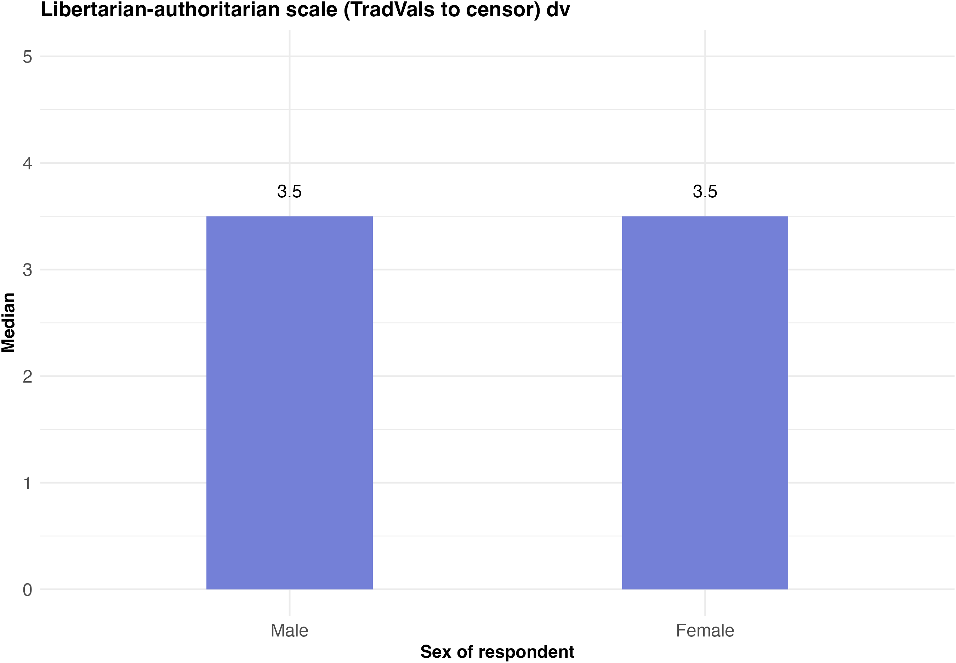
Unweighted sample sizes: Male: n=1217 | Female: n=1385

Slide 5
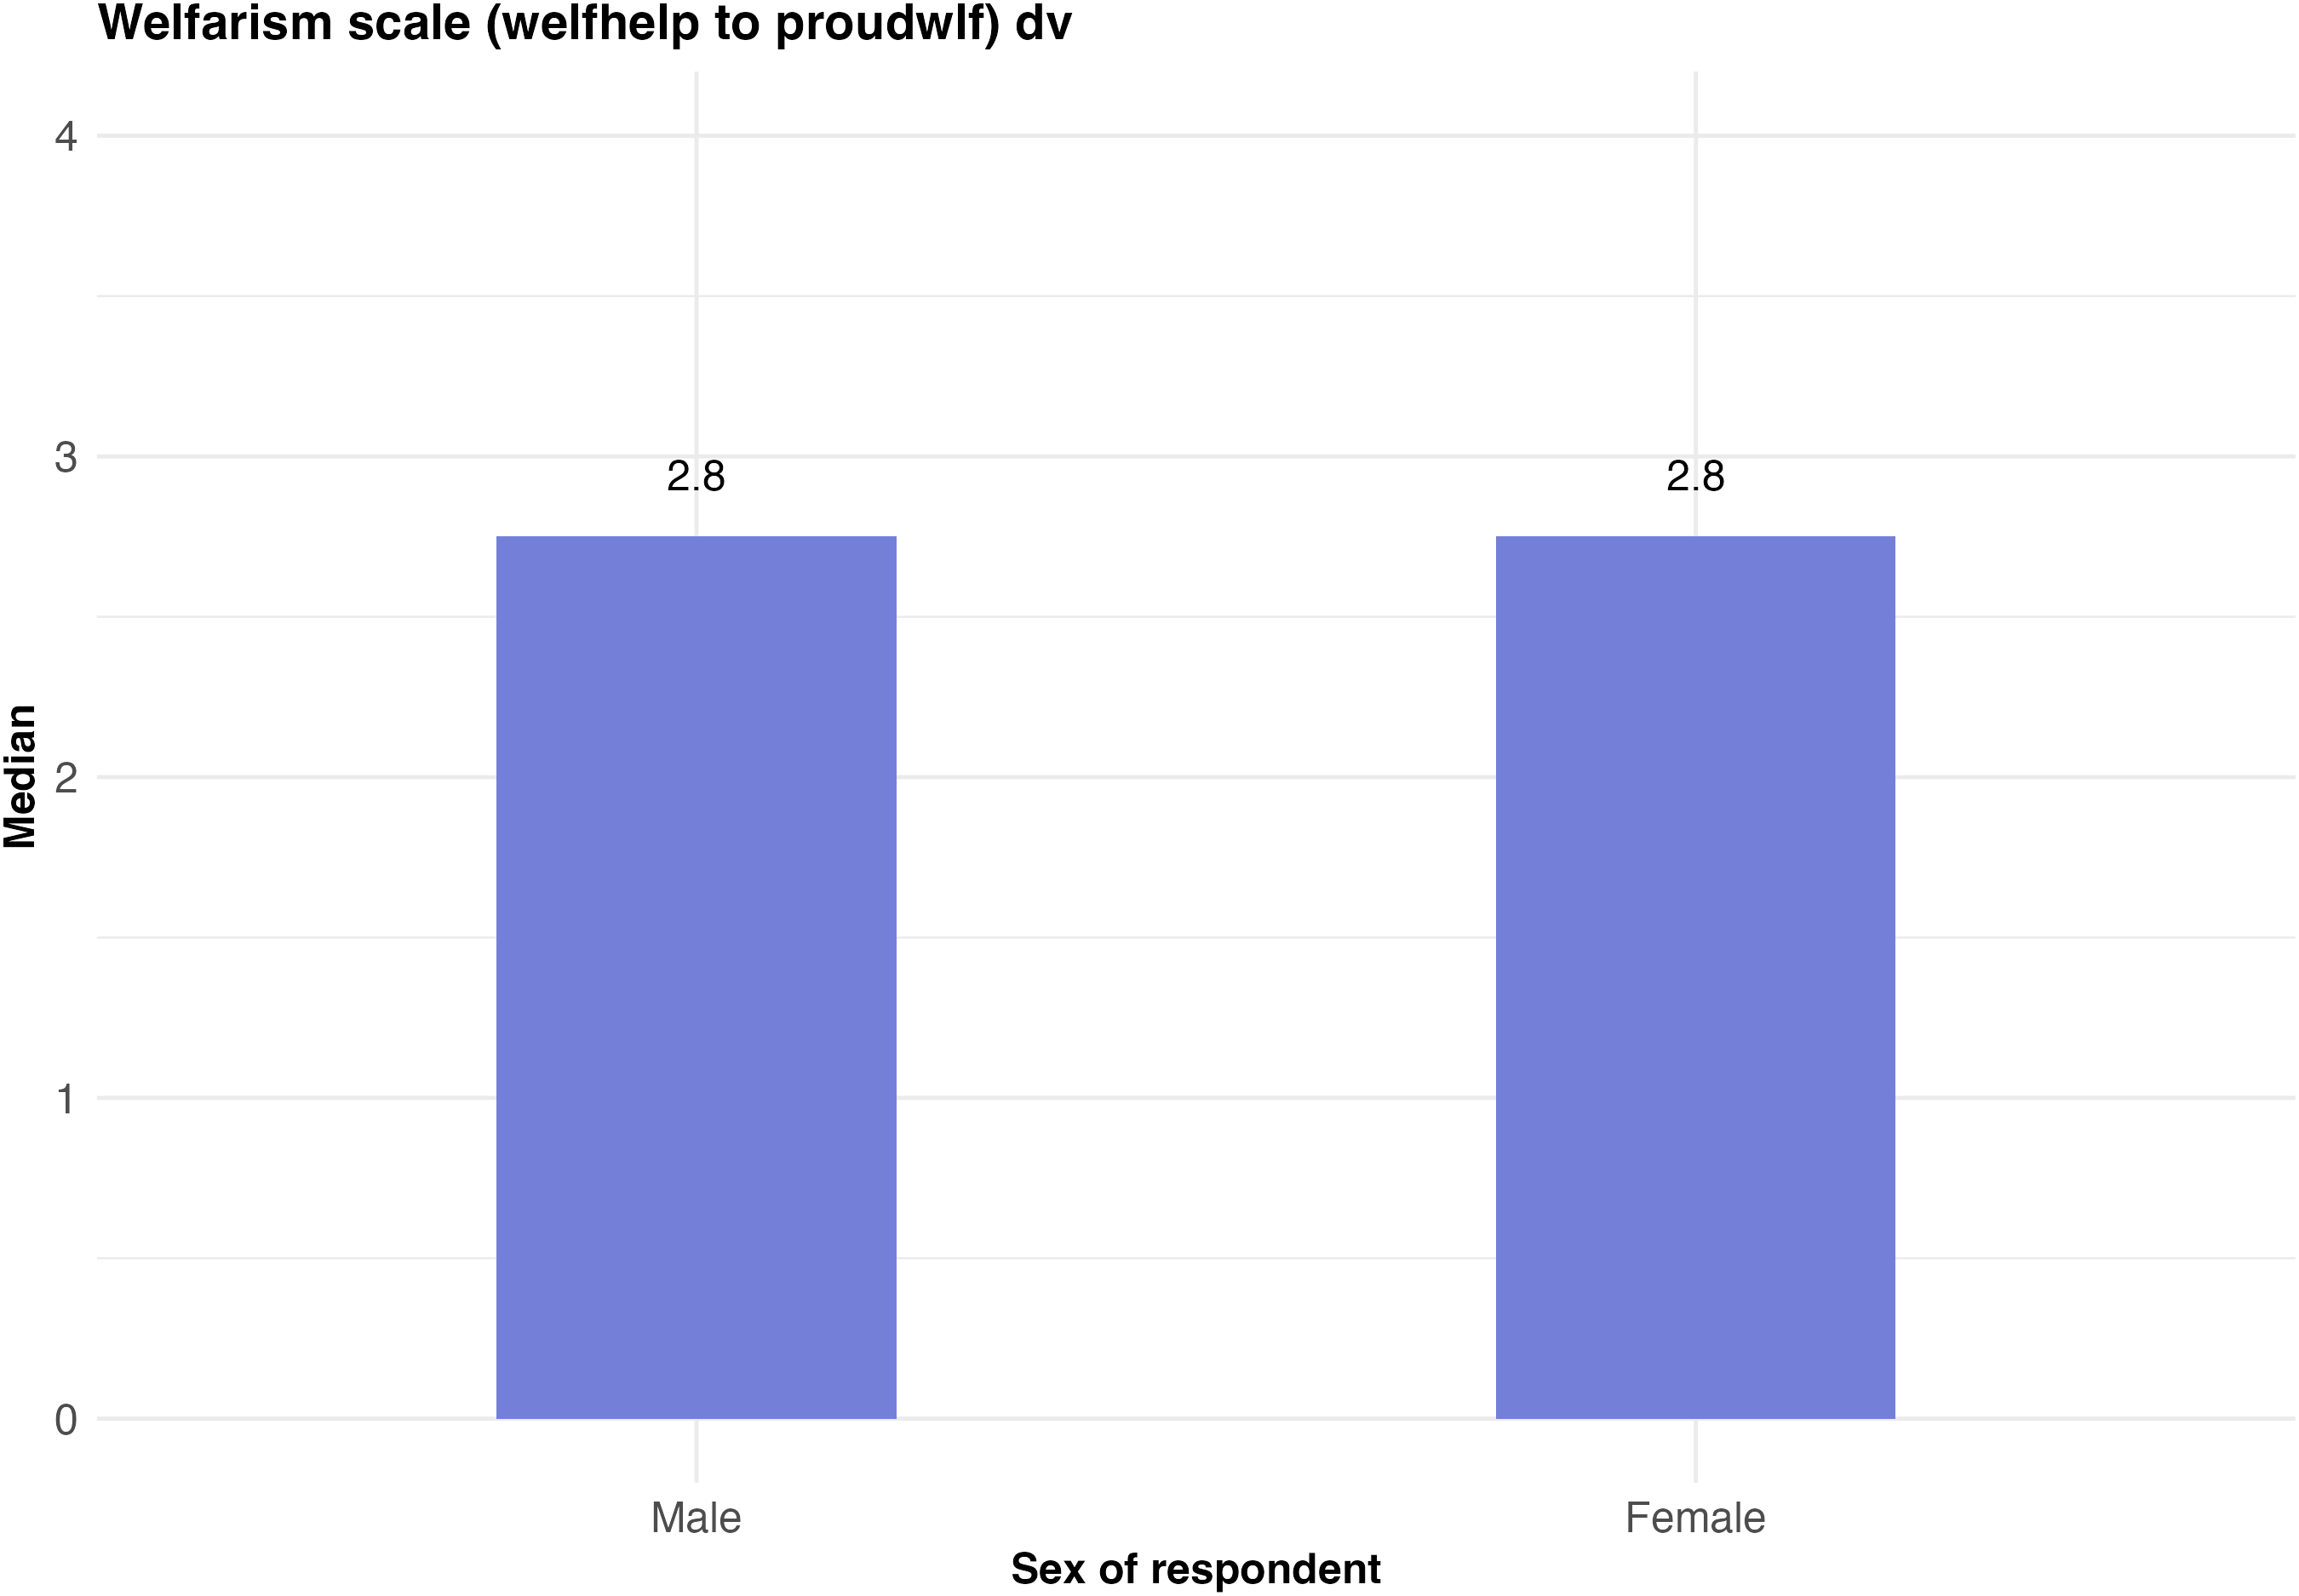
Unweighted sample sizes: Male: n=1217 | Female: n=1386

Slide 6
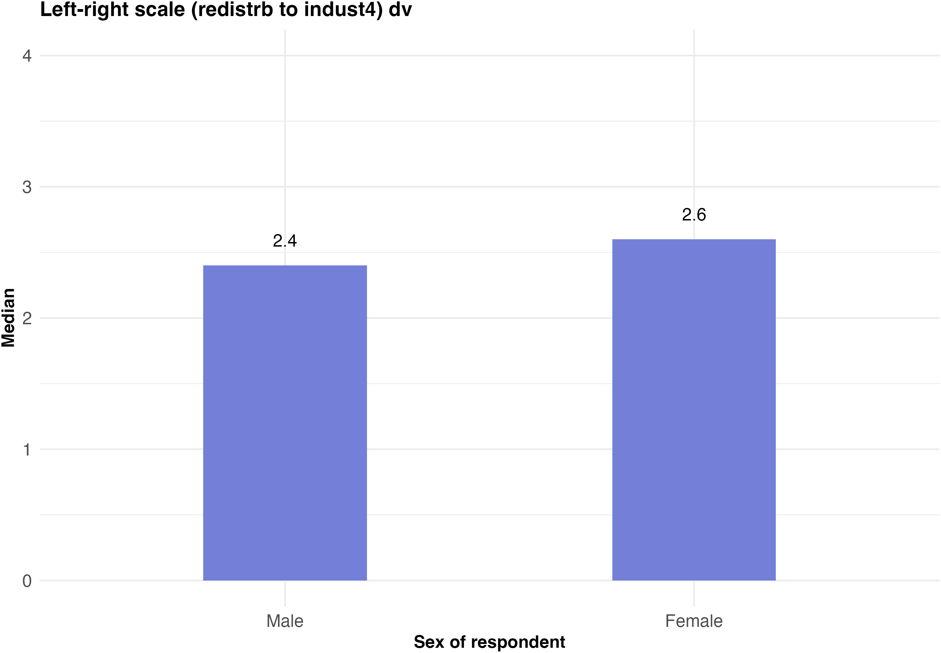
Unweighted sample sizes: Male: n=1212 | Female: n=1382

